Slide 1
Implementation of Network with systems, Firewall and VPN
Group-1
Sai Keerthi pyata-11699533
Yenugu Ruthiksha Reddy-11714976
SriCHARAN-11700300

Slide 2
Introduction
The Project is about the Implementation of Network with systems, Firewall and VPN.
The System is Kali, Firewall, IDS and VPN is FortiGate.
The second required is the security of the systems we have used Burp Suite and ZAP for the Security Check.
Implemented the Nmap for open ports and rules.
Done the packet analysis of the Firewall and the client using the Wireshark.
As an Additional we have setup the basic network in cloud with the port restriction implementation which is a feature of firewall.

Slide 3
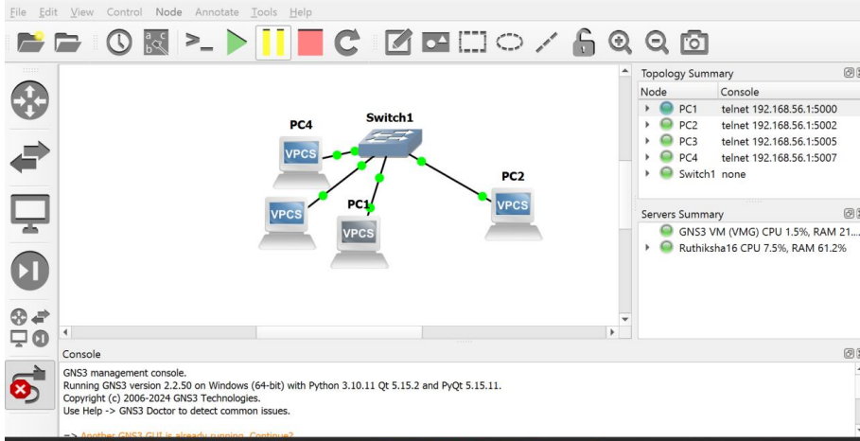
GNS3 Setup with Basic Network

Slide 4
GNS3
In GN3 we have created the sample network of 4 systems and connected over that to the switch.
This is the simple Intra Network.
We have done the communication check of the systems using the ping.
We have attached the images of GNS3, Systems, Network communication and VM true Enablement.
We have done the trouble shotting of GNS3 in windows 10 for KVM True which was a major issue.

Slide 5
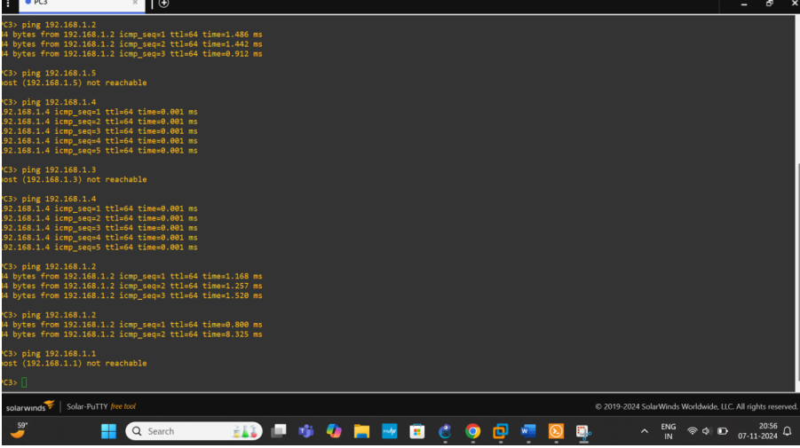
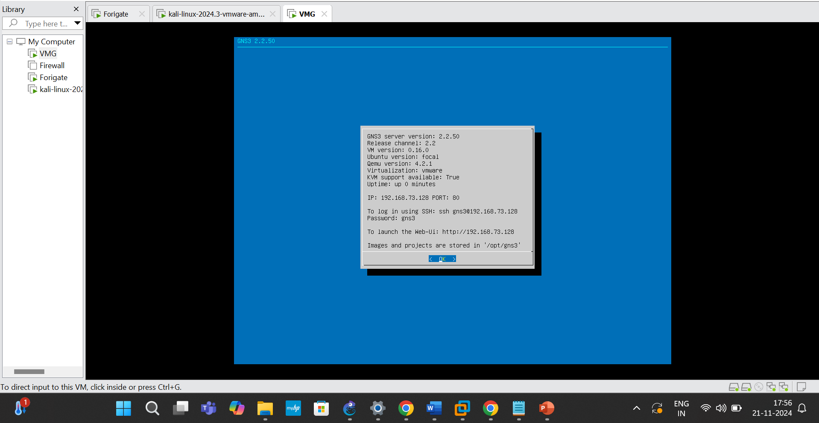

Slide 6
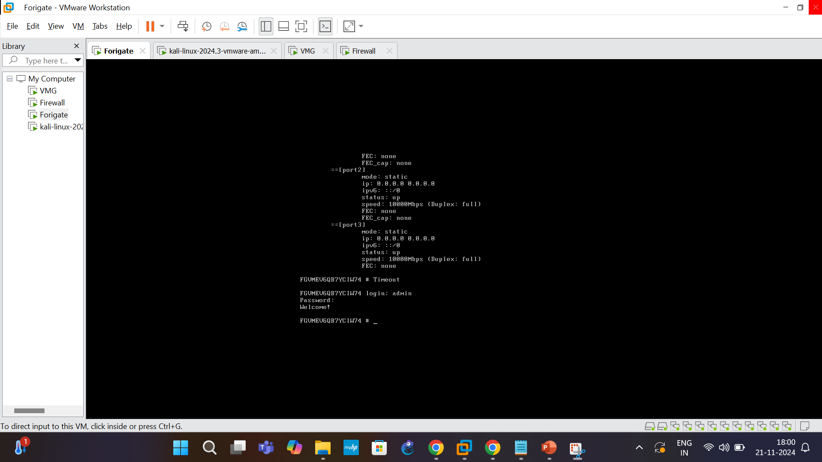
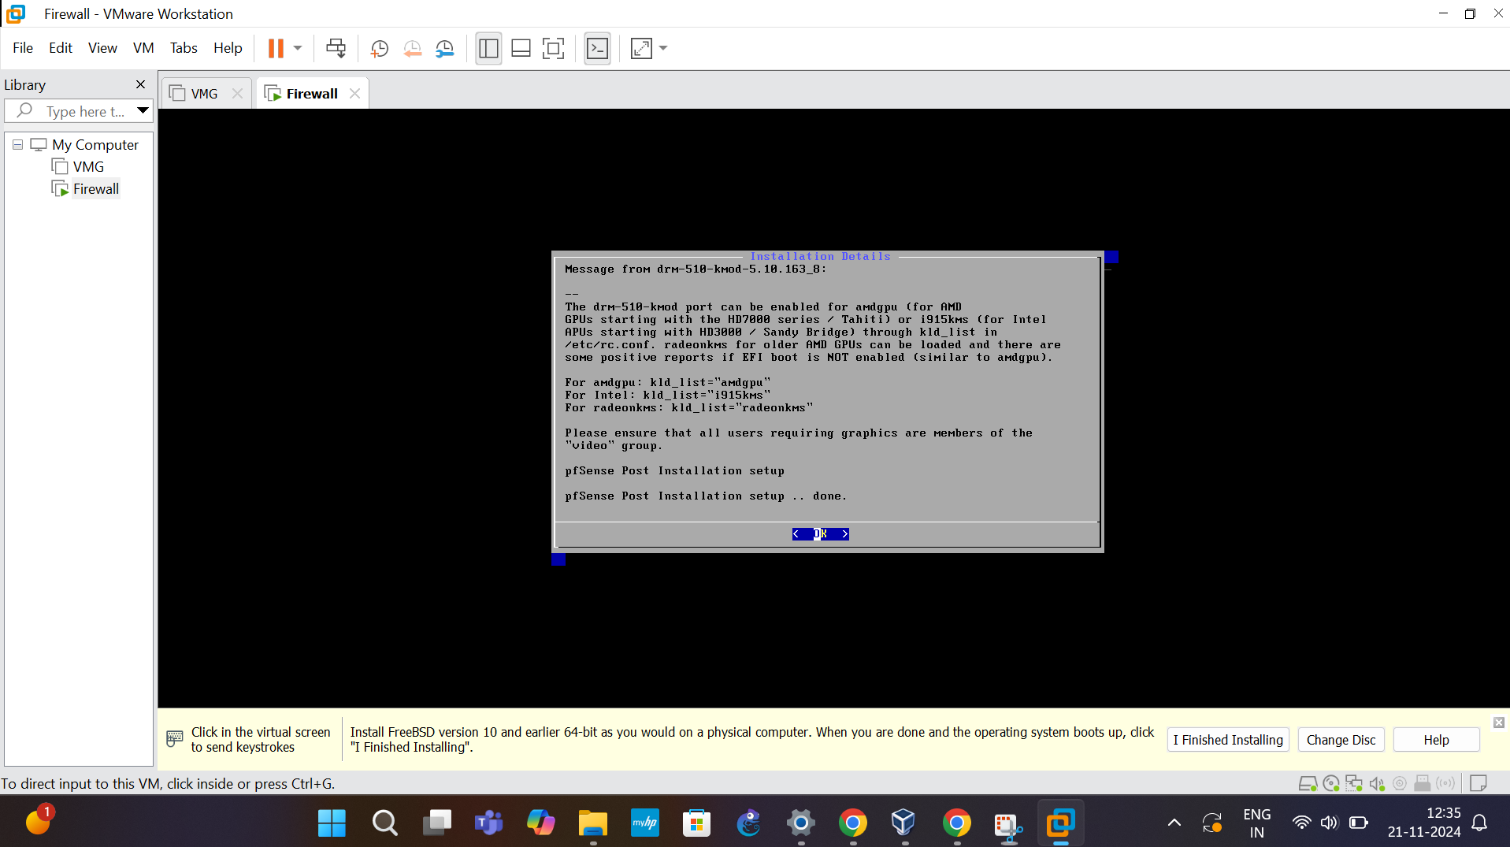

Slide 7
The slide was the setup of P-sense Firewall, FortiGate Firewall, VPN and IDS, IPS of Fortinet and Application control access.
In the image you can see the setup of Client as Kali, Network Security tools Fortinet and P-sense.
We have communicated using Ping and Nmap with the tools.
The slides

Slide 8
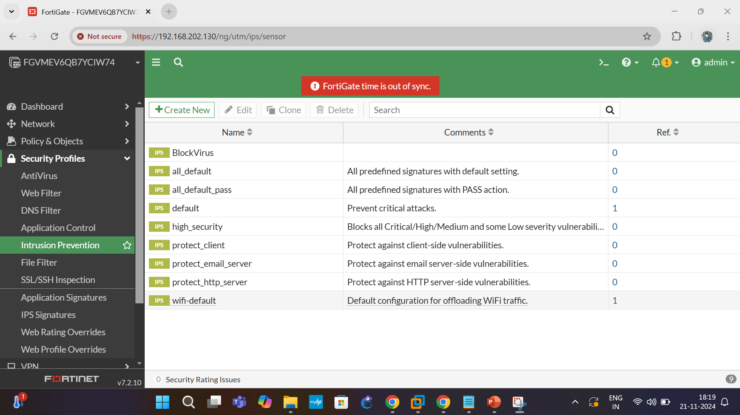

Slide 9
We have deployed the Fortinet which is a Firewall, VPN and access control tool.
It has features of blocking the Applications for the users.
It will act as IPS, IDS, Network Firewall, Port Forwarding and Routing the application/server.
It can act as load balancer for the applications.
We can use this as VPN as we require a server IP address to host in the Fortinet.
It can act as Virus Prevention, Application access control, File Type Prevention while transfer.
This Tool helps in most of the security prevention and control.

Slide 10
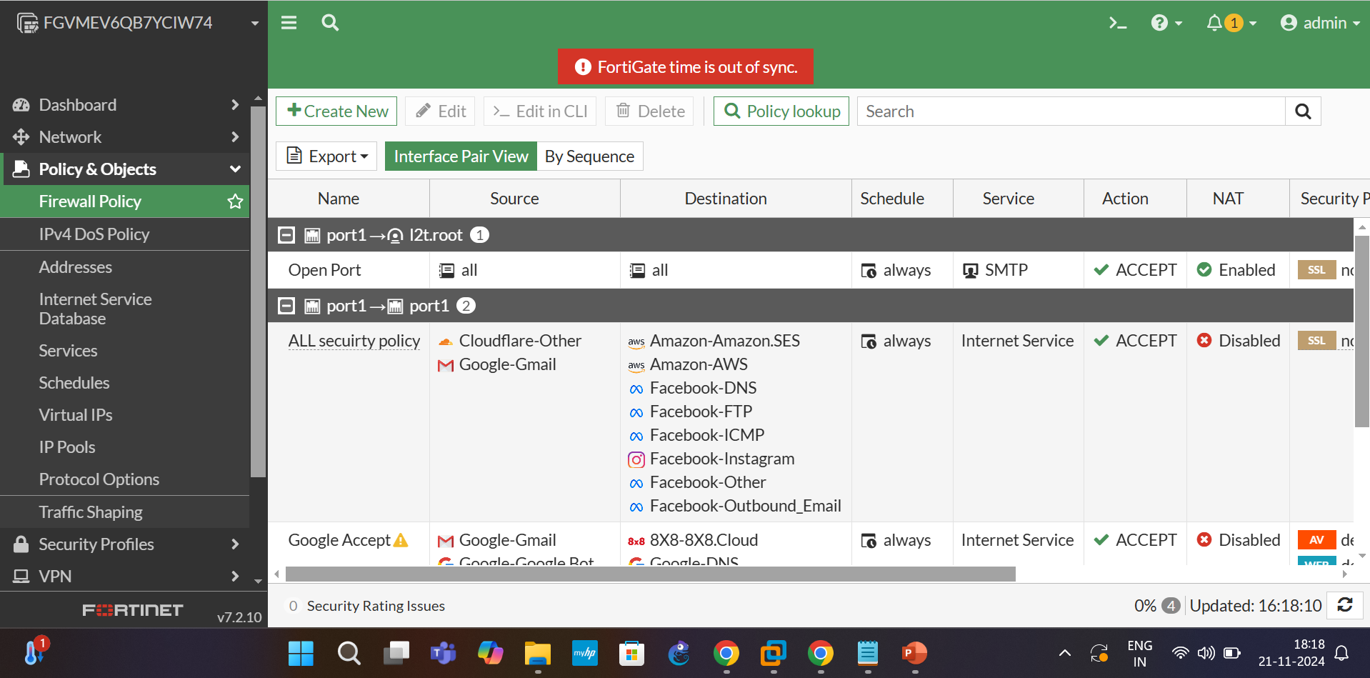

Slide 11
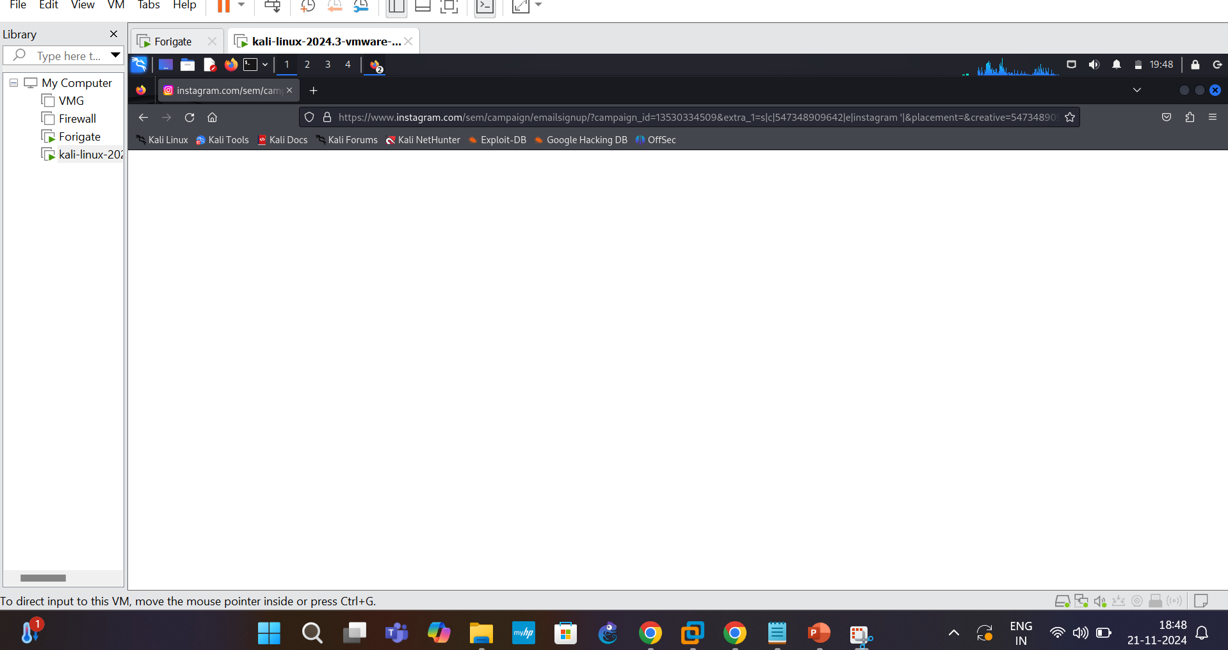

Slide 12
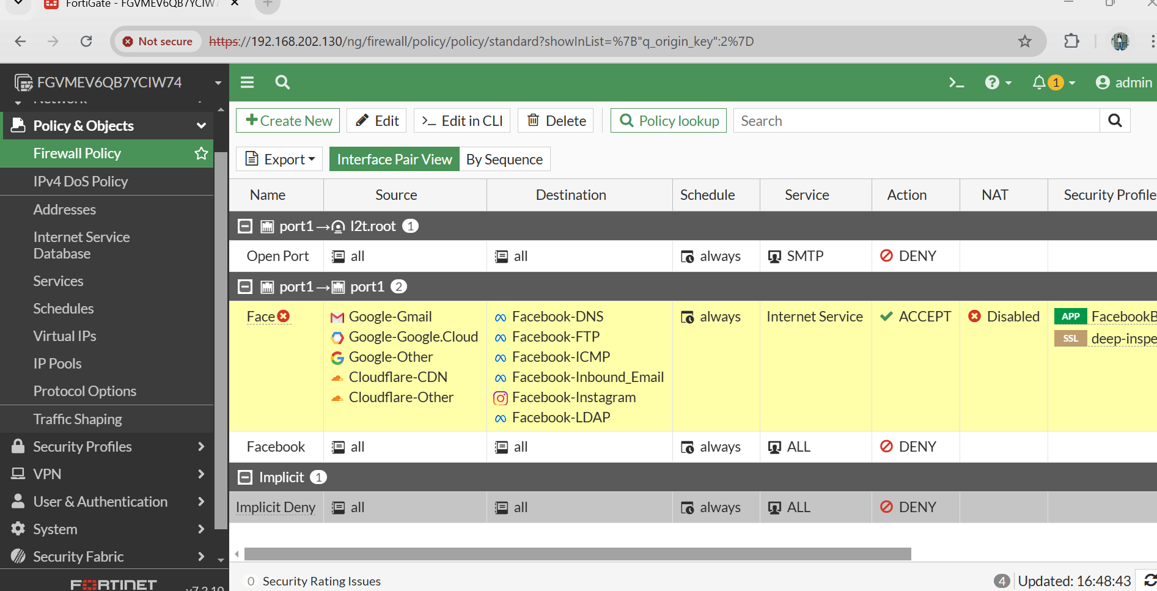
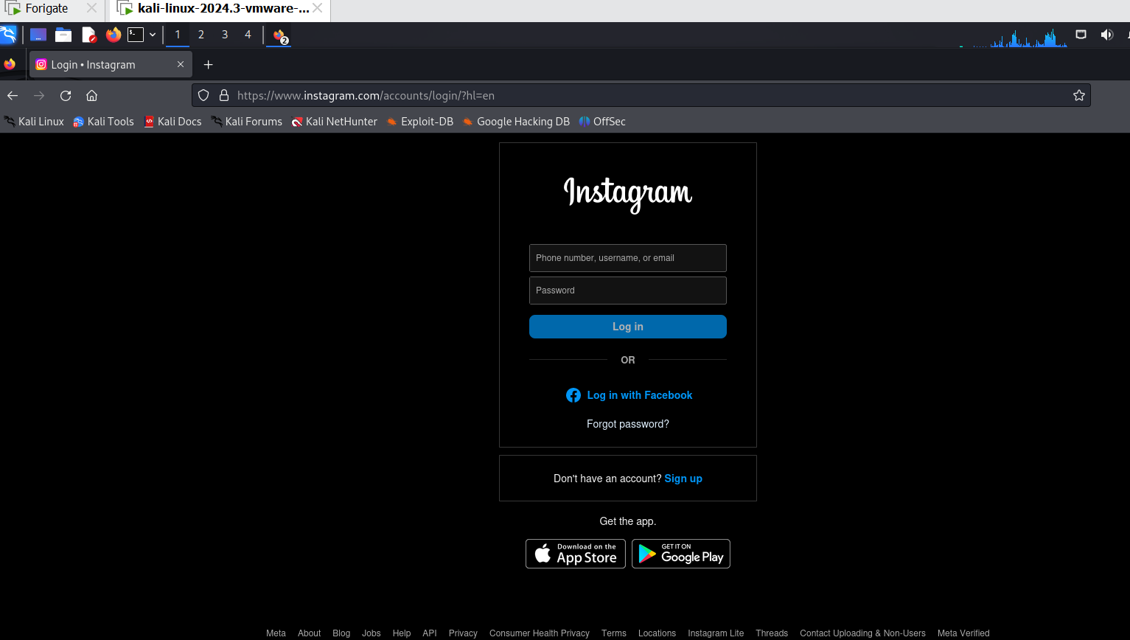

Slide 13
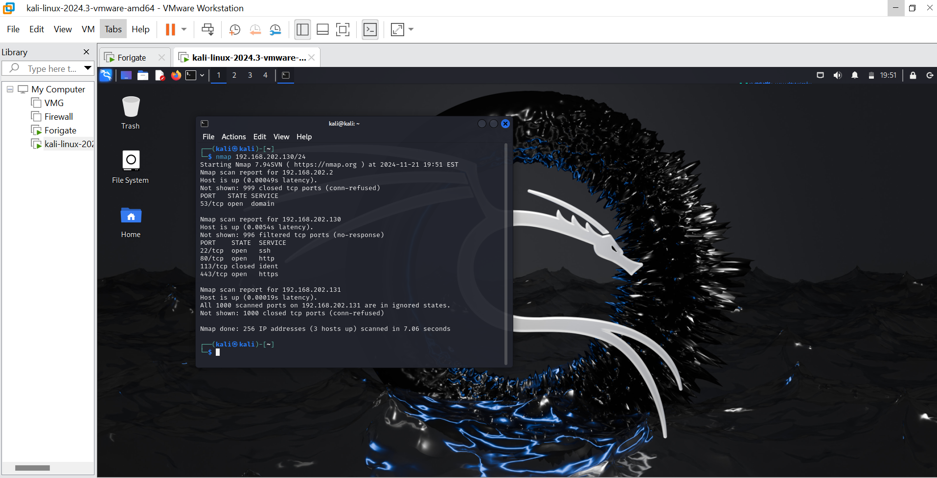

Slide 14
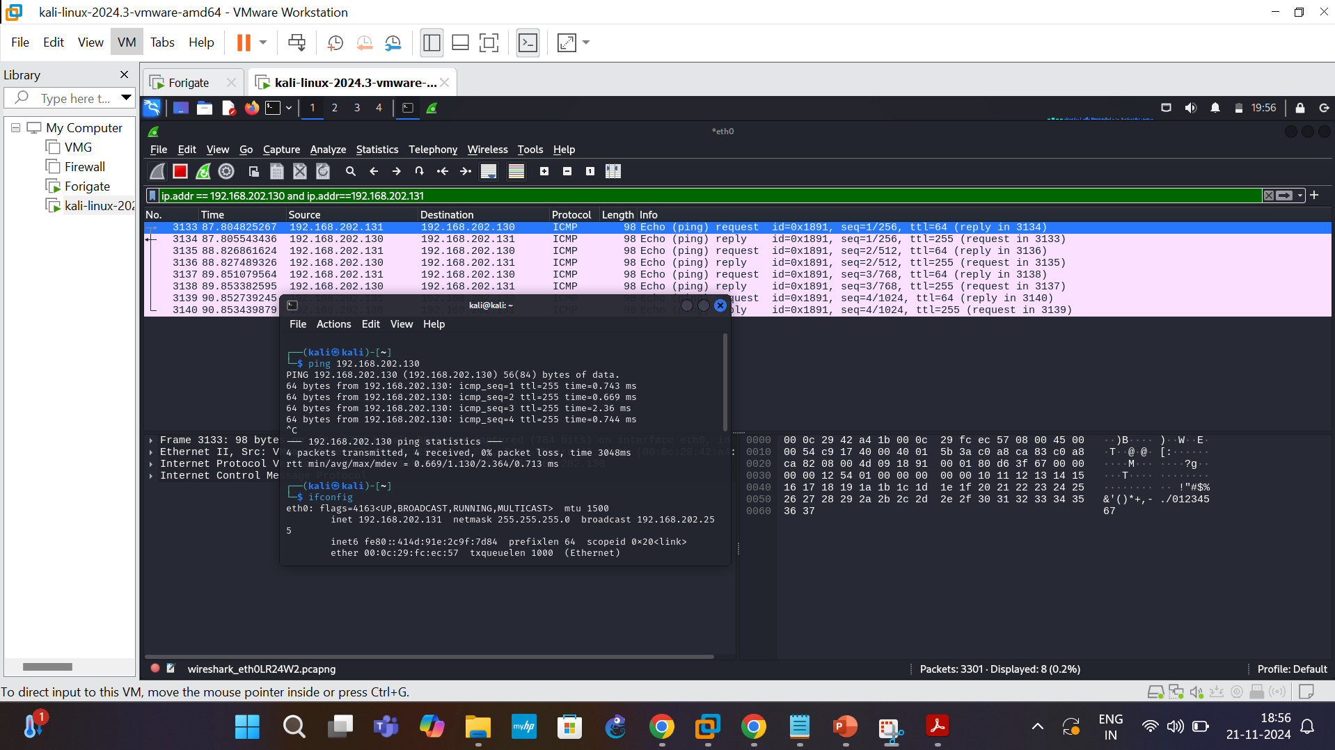

Slide 15
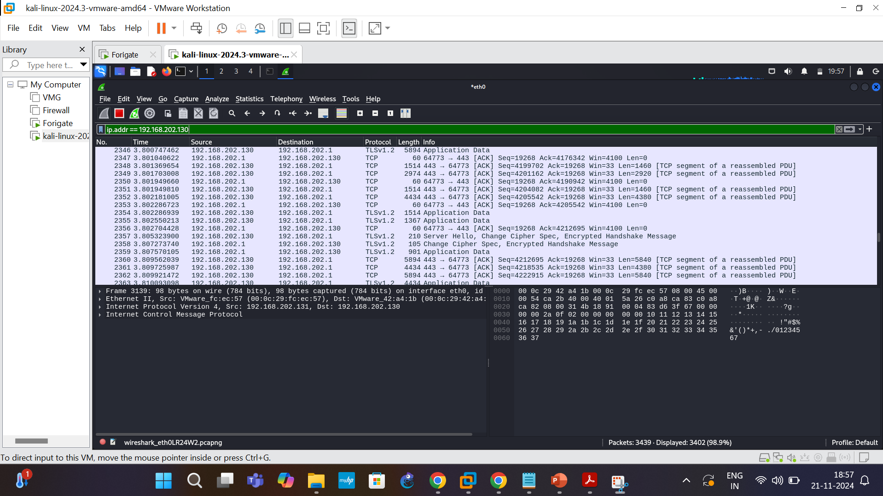

Slide 16
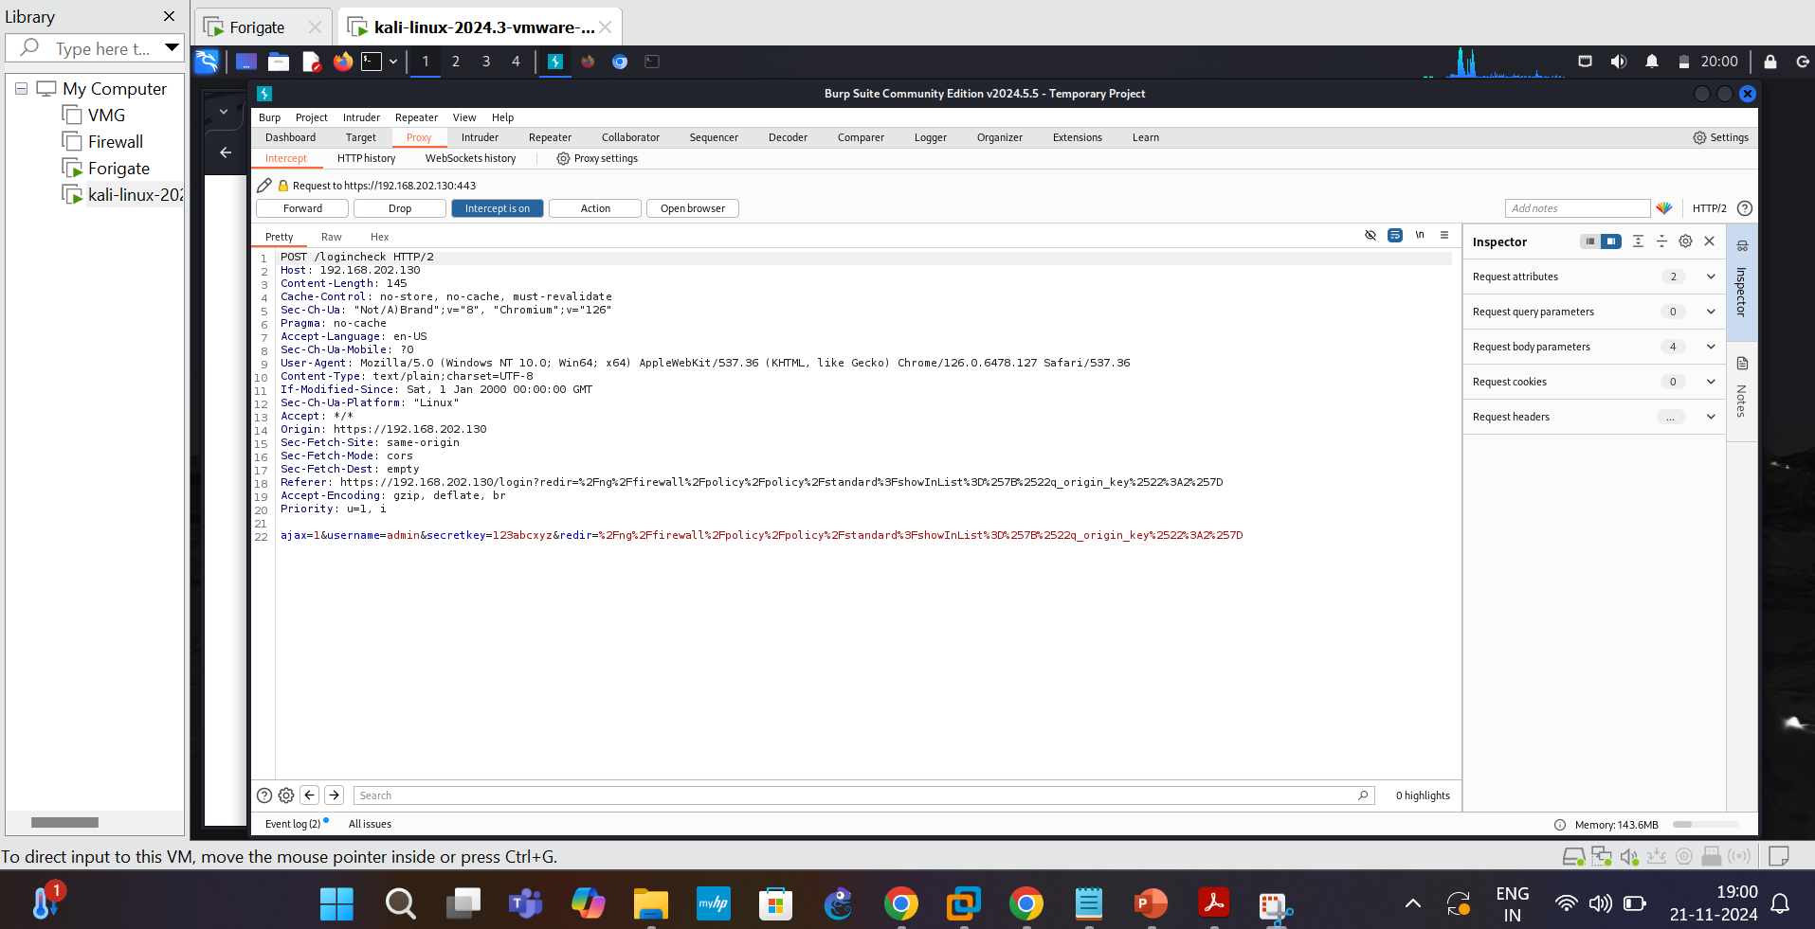

Slide 17
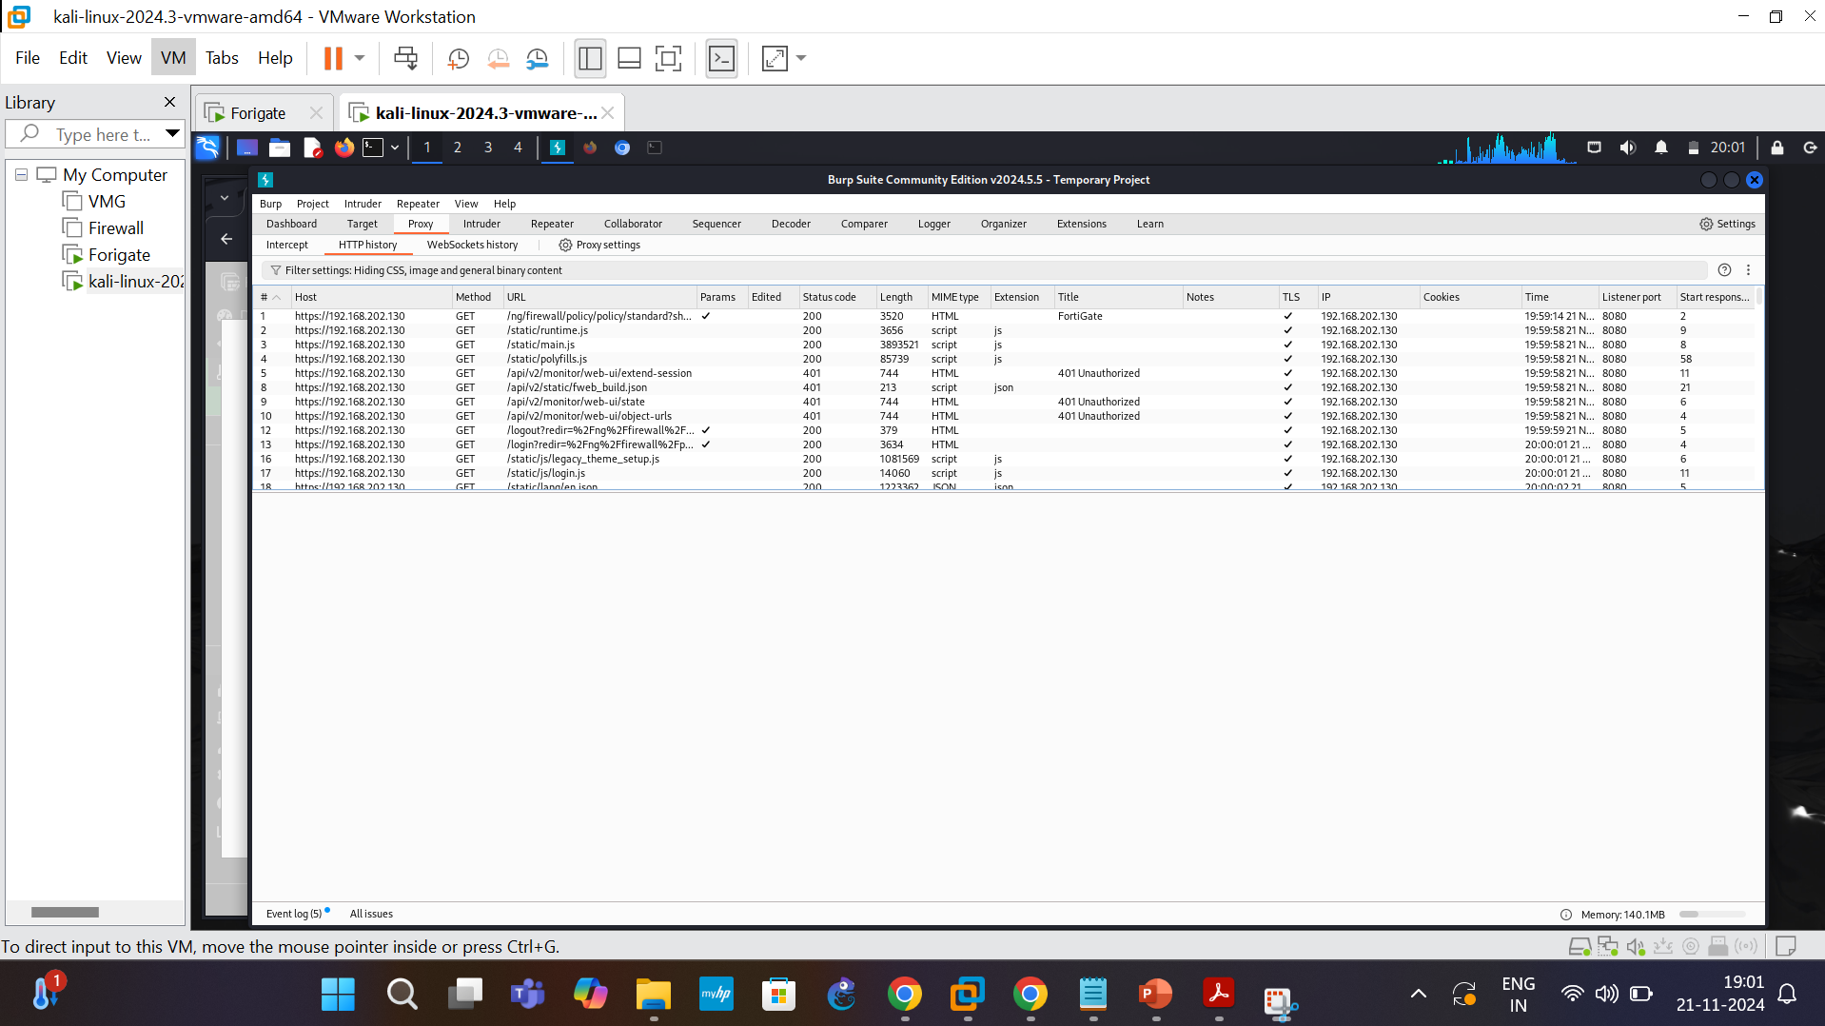

Slide 18
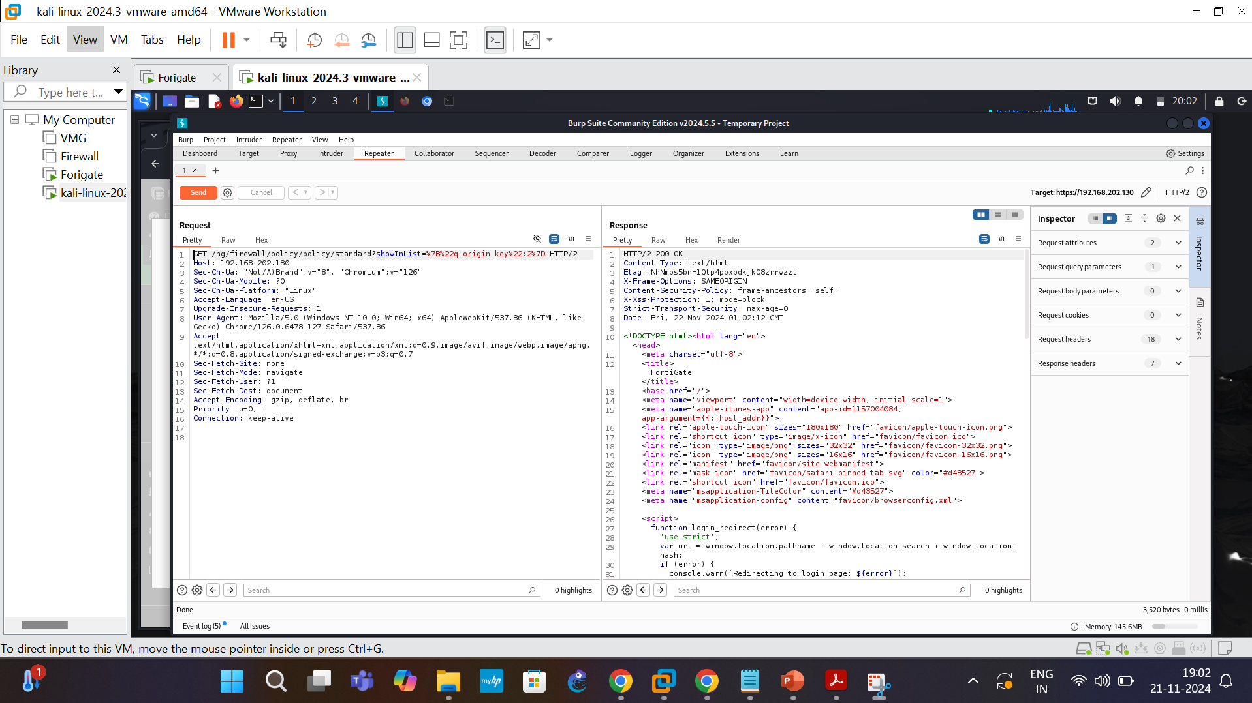

Slide 19
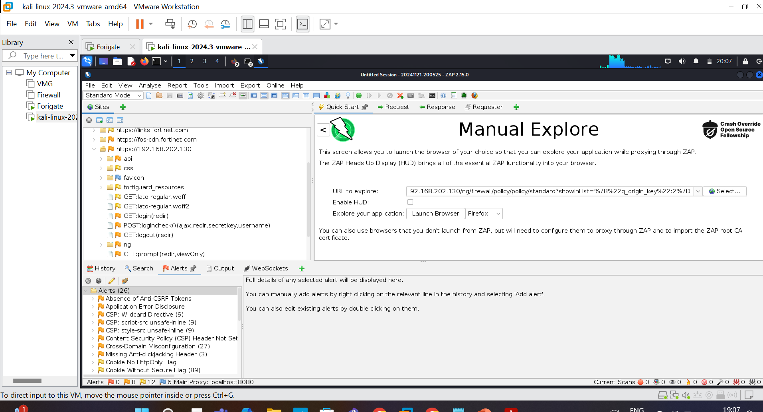

Slide 20
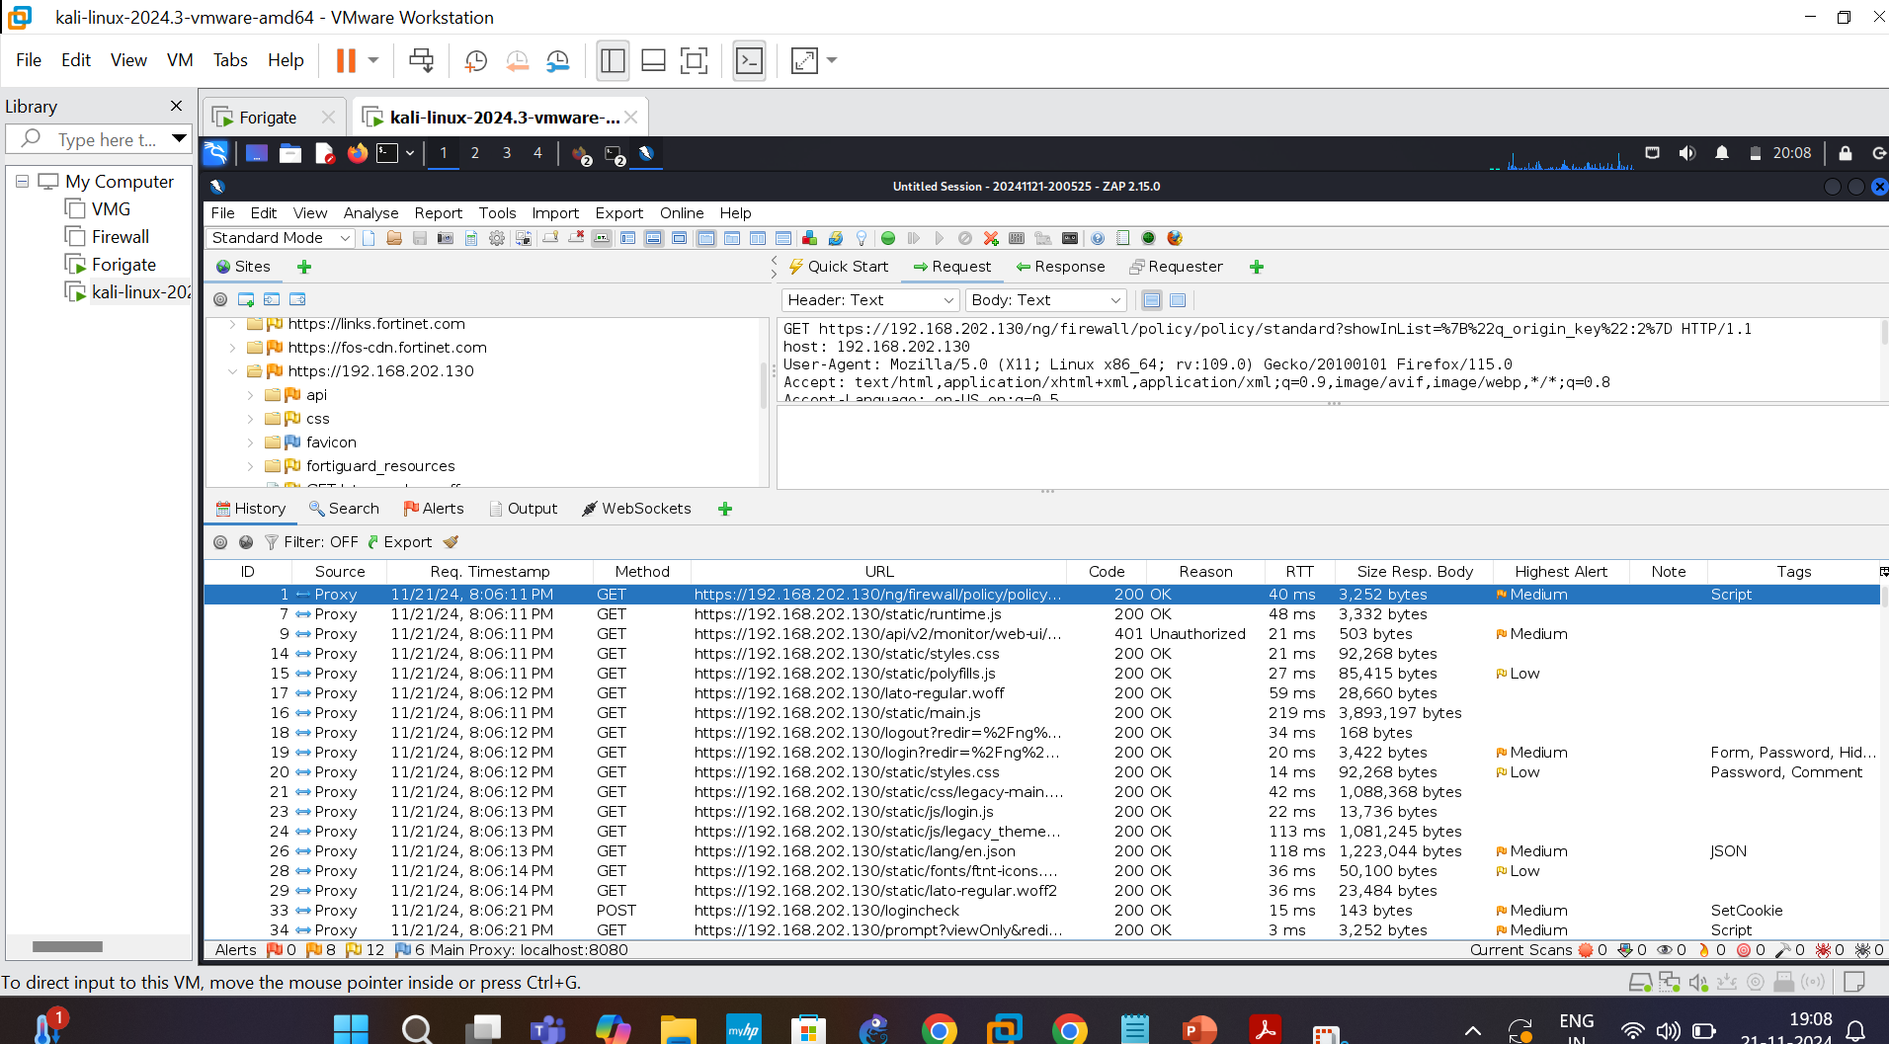

Slide 21
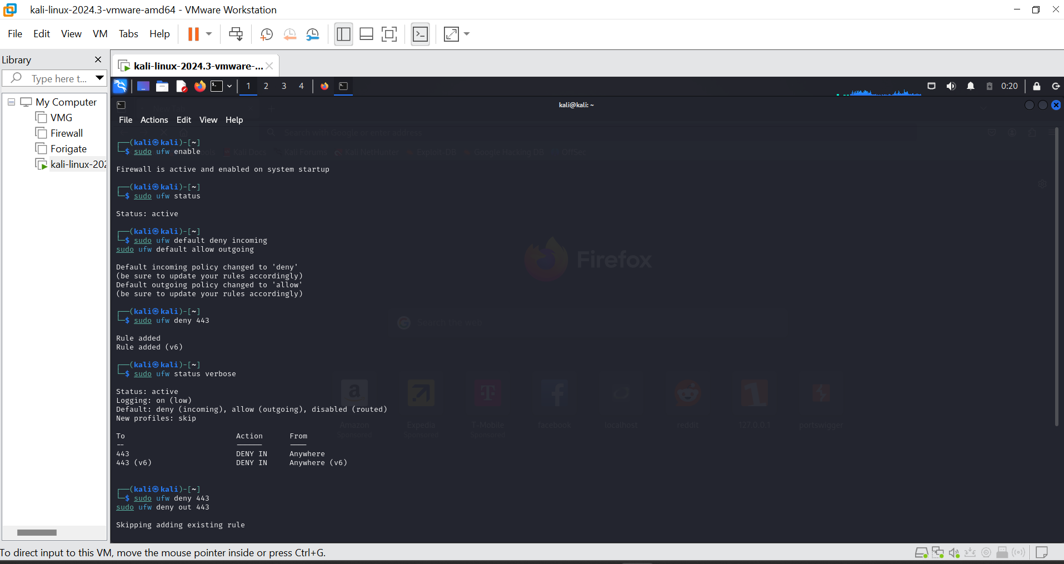

Slide 22
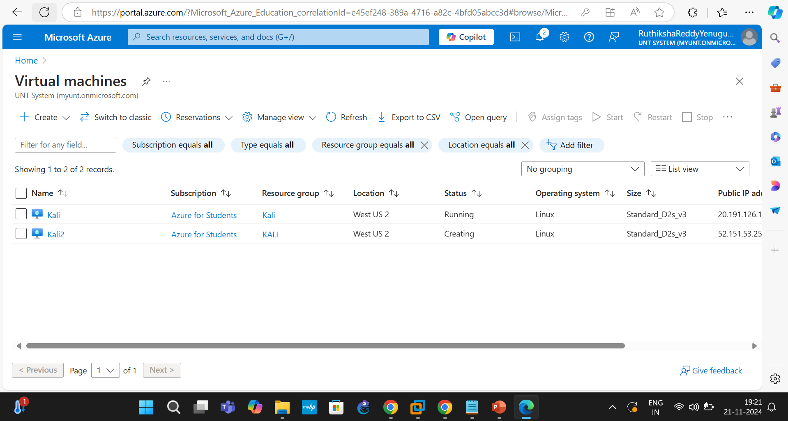
Basic Network in the Cloud

Slide 23
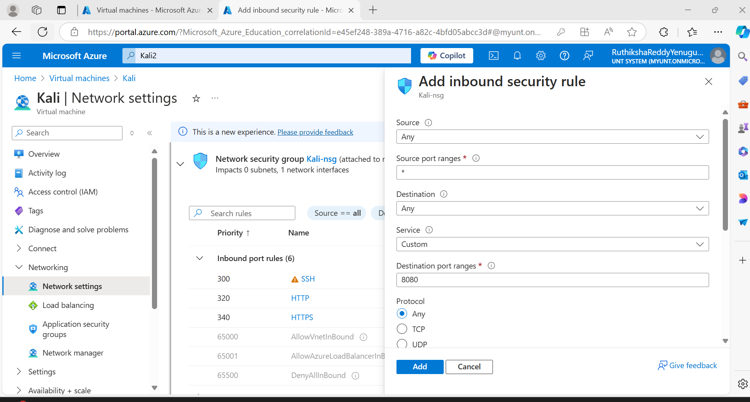

Slide 24
In the above I have deployed the two systems in the cloud in same network.
In the images I have shown the deployment of kali systems and the basic firewall rules for inbound and outbound.
We can create the rules for blocking and unblocking the protocols and traffic in the rules of the azure cloud.

Slide 25
We have understand about the communication of same network using the ping.
We have accessed the servers using the ssh if it’s a different network with public IP address.
We have understand about the security using the Burp Suite and ZAP which we have identified he vulnerabilities in the Firewall and client.
We have done the Nmap scan for the Firewall and No of systems in the same network.
We have done the packet analysis of the system, VPN and Firewall.
In final we can say we have done the work of both the combination of network and security in both the on-premises and Cloud using the VMware and Microsoft Azure.

Slide 26
Thank You

